Slide 1
Appi-Gration
The new way to immigrate
Presented by:
Anumolu Sandeep Prasad 13156974
Constant Hughes - Treherne 13340384
Udaya Bhaskar Reddy Malkannagari 13368171
Lum Kwan Wei Brandon 13379339

Slide 2
What is Appi-Gration
Tailored accommodation search application
Specifically designed to streamline immigration residential procedures

Slide 3
The Team
Scrum Master
Sandeep
Product Owner
Uday
Development Team
Brandon
Constant

Slide 4
Sprint Breakdown
Each Sprint in structured in the most efficient way
4 Sprints were executed to complete the entire project

Slide 5
Overall Sprint Schedule
Sprint 1
December 18 - December 24
l 1 Week Interval l
Sprint 2
January 1 - January 7
Sprint 3
January 8 - January 14
Sprint 4
January 15 - January 21

Slide 6
How our burndown charts work?
Sprint | Effort Points
Sprint 1 | 6
Sprint 2 | 4
Sprint 3 | 4
Sprint 4 | 5

Slide 7
Sprint 1
Planning Phase
Weekly meeting schedule
Communication channels
Layout structure
Navigation flow

Slide 8
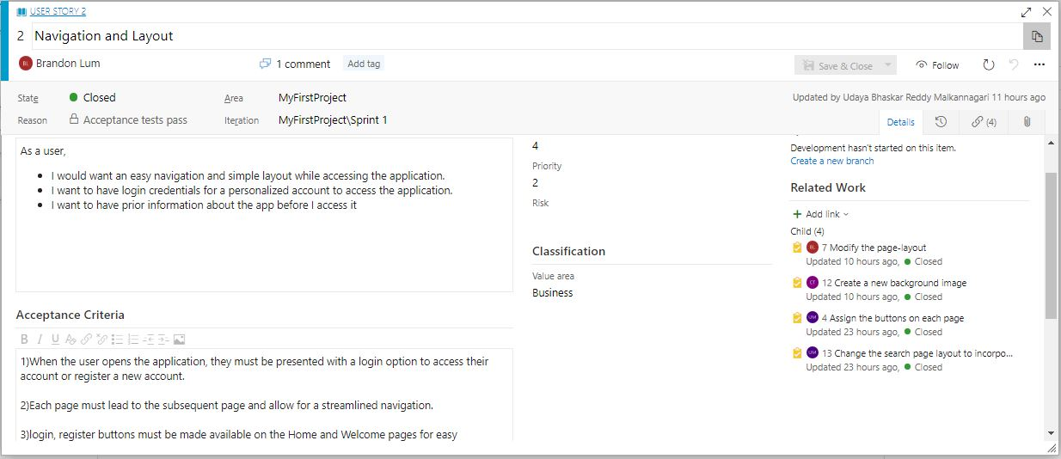
Sprint 1
Sprint User Story
Easy navigation
Simple layout
Continue browsing without an account
Brief info on the app
Acceptance Criteria
Easily visible and functioning buttons
Layout accessible on multiple devices
‘Two-click’ functionality

Slide 9
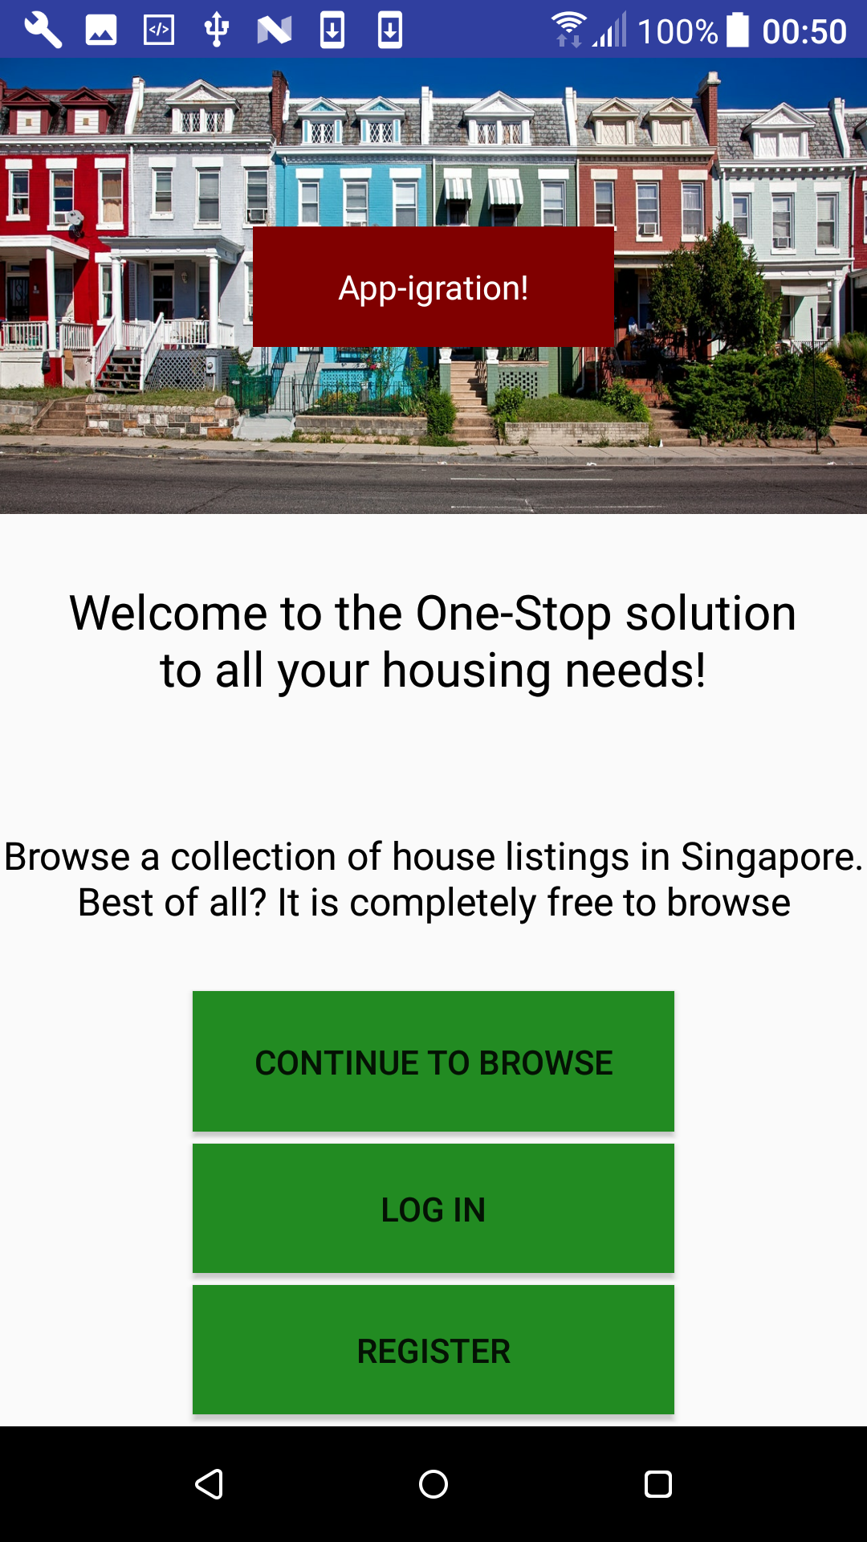
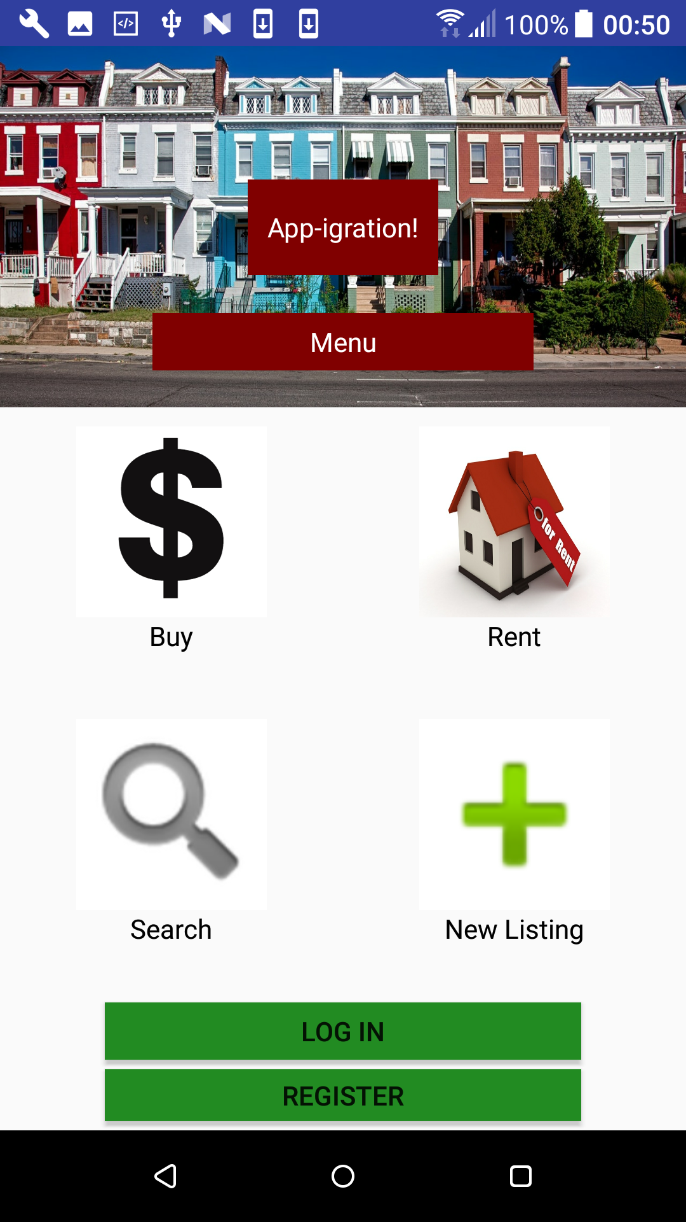
Sprint 1

Slide 10
Sprint 2
Planning Phase
Provide authorized access to user
Feasibility of a free account
Secure access to the user

Slide 11
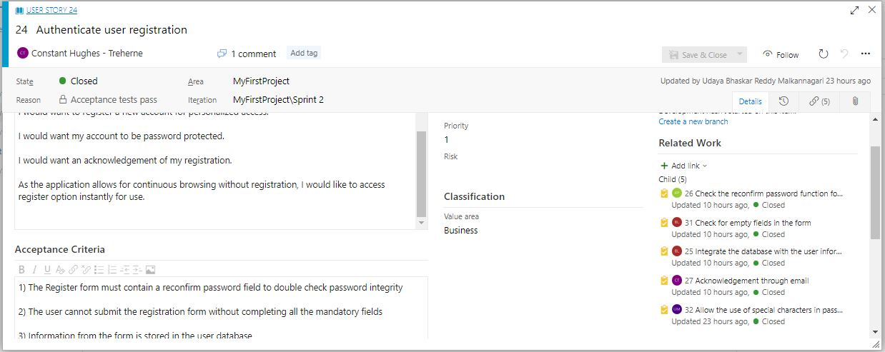
Sprint 2
Sprint User Story
Register an account
Account should be secure
Free Account
Acknowledgement
Acceptance Criteria
Account is password protected
Wrong password prompts an error
Successful registration is highlighted

Slide 12
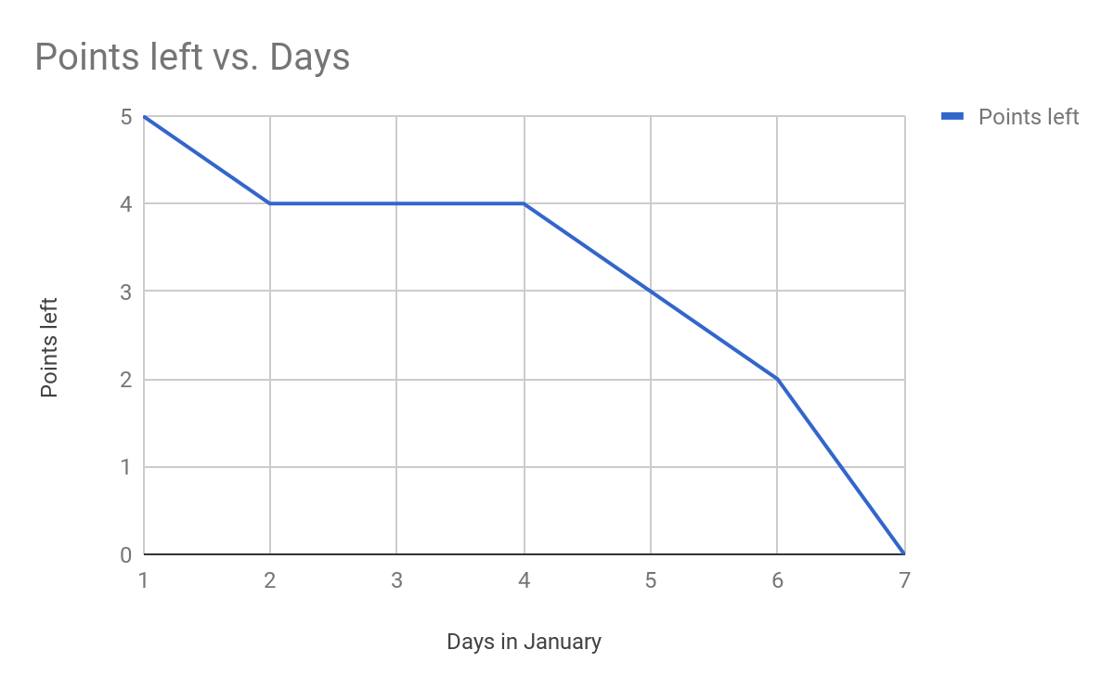
Burndown Chart: Sprint 2

Slide 13
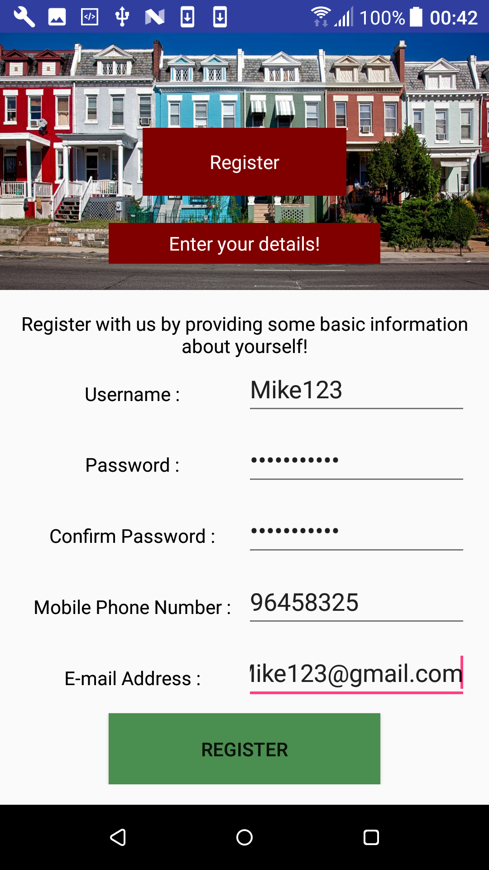
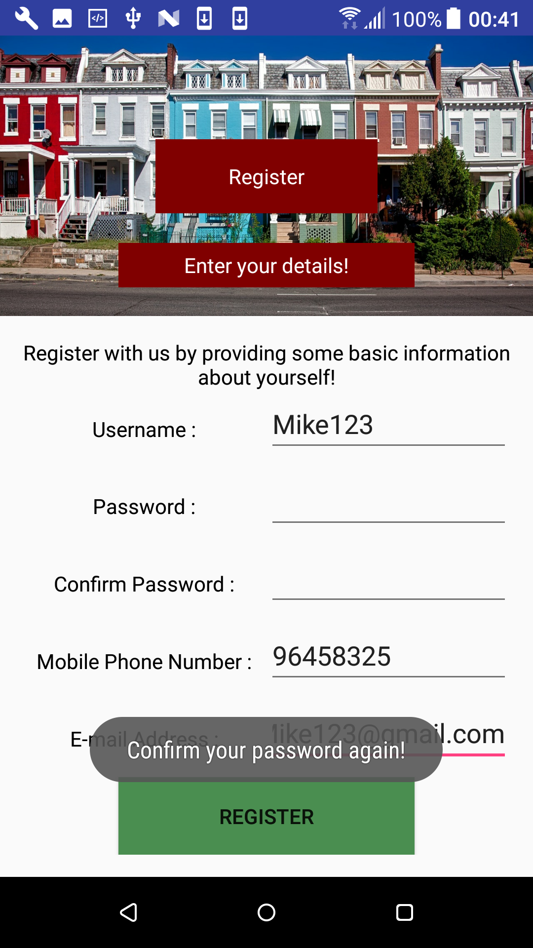
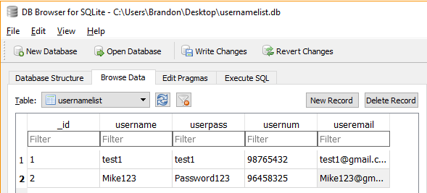
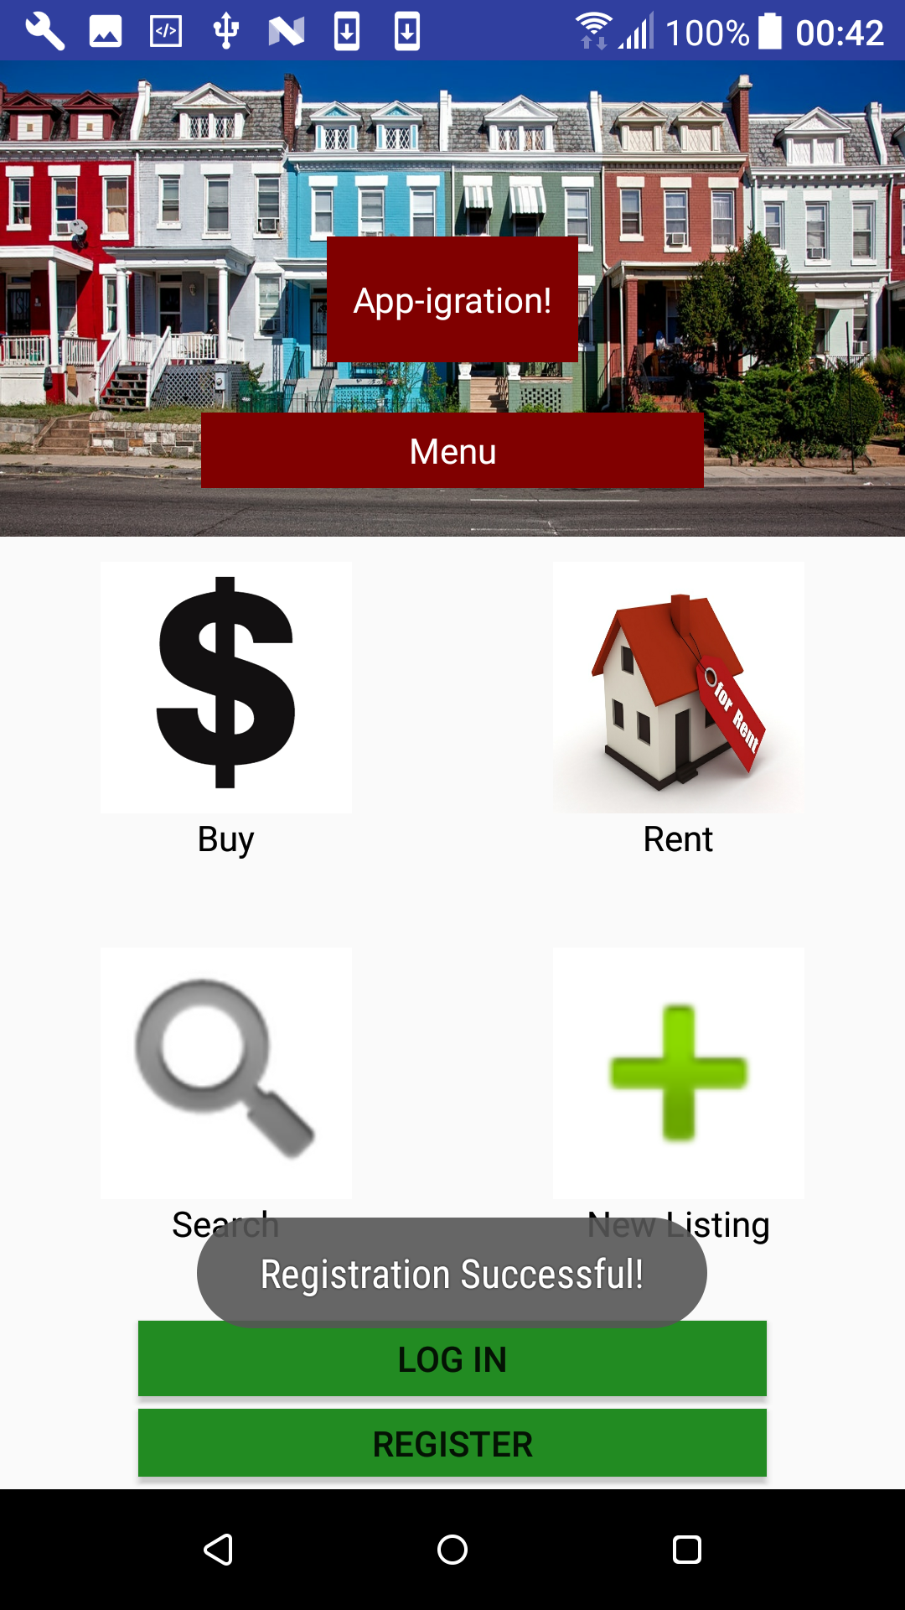
Sprint 2 : Registration

Slide 14
Sprint 3
Planning Phase
Personalise the user’s experience

Slide 15
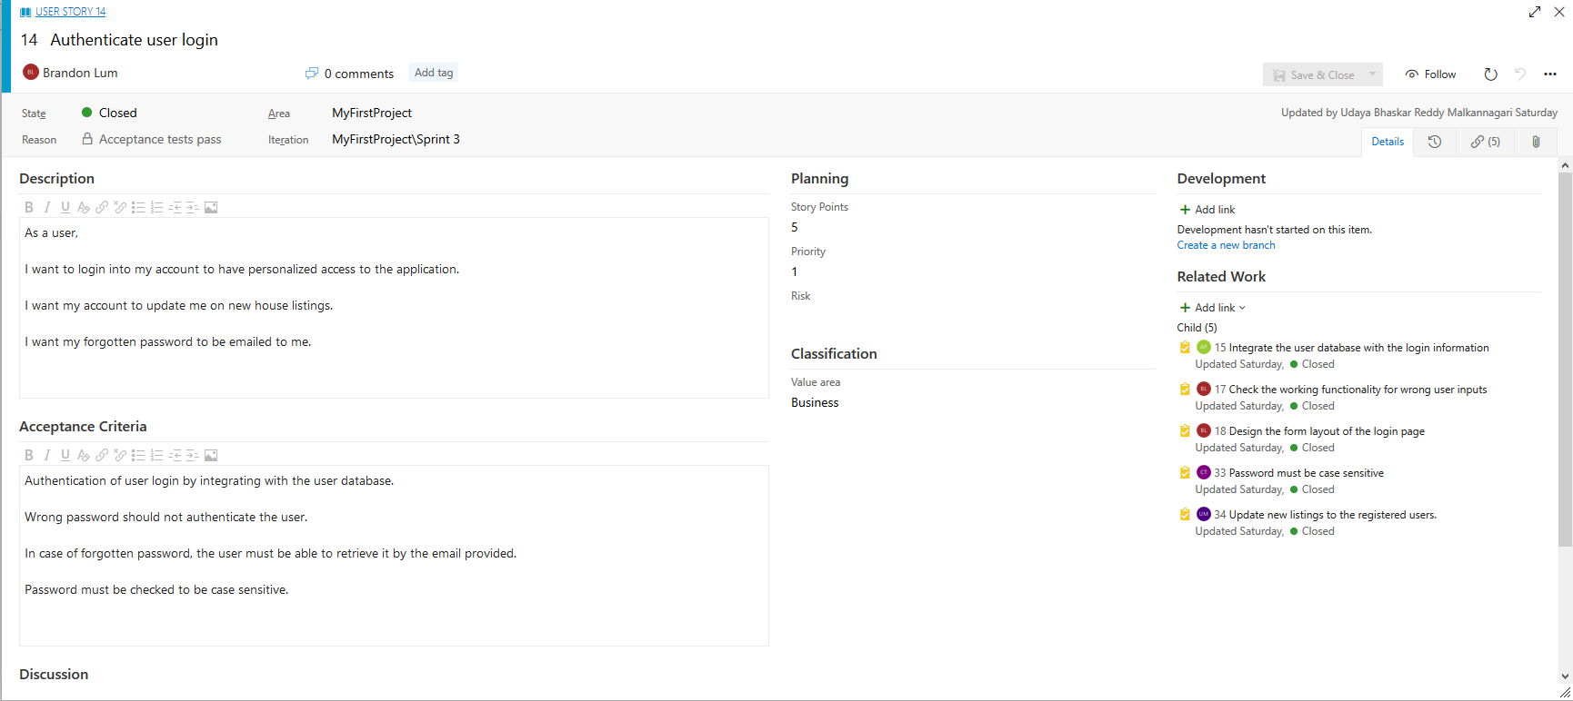
Sprint 3
Sprint User Story
Personalized access
Update on new listings
Password retrieval
Acceptance Criteria
Integrate user account with database
Wrong input should not authenticate
Password can accept special characters
Password is case sensitive

Slide 16
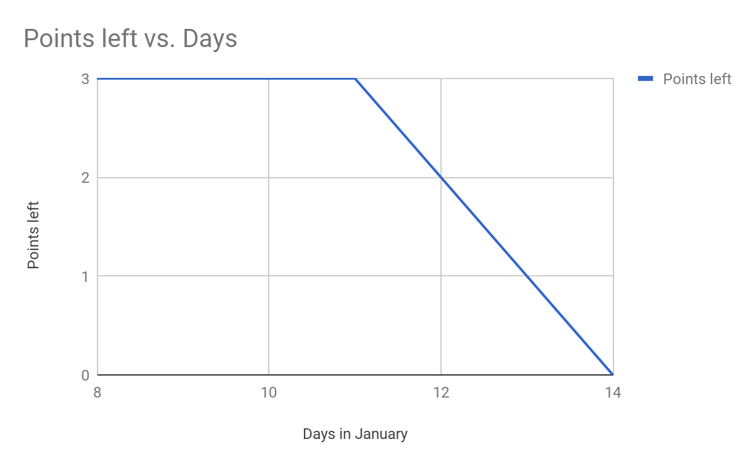
Burndown Chart: Sprint 3

Slide 17
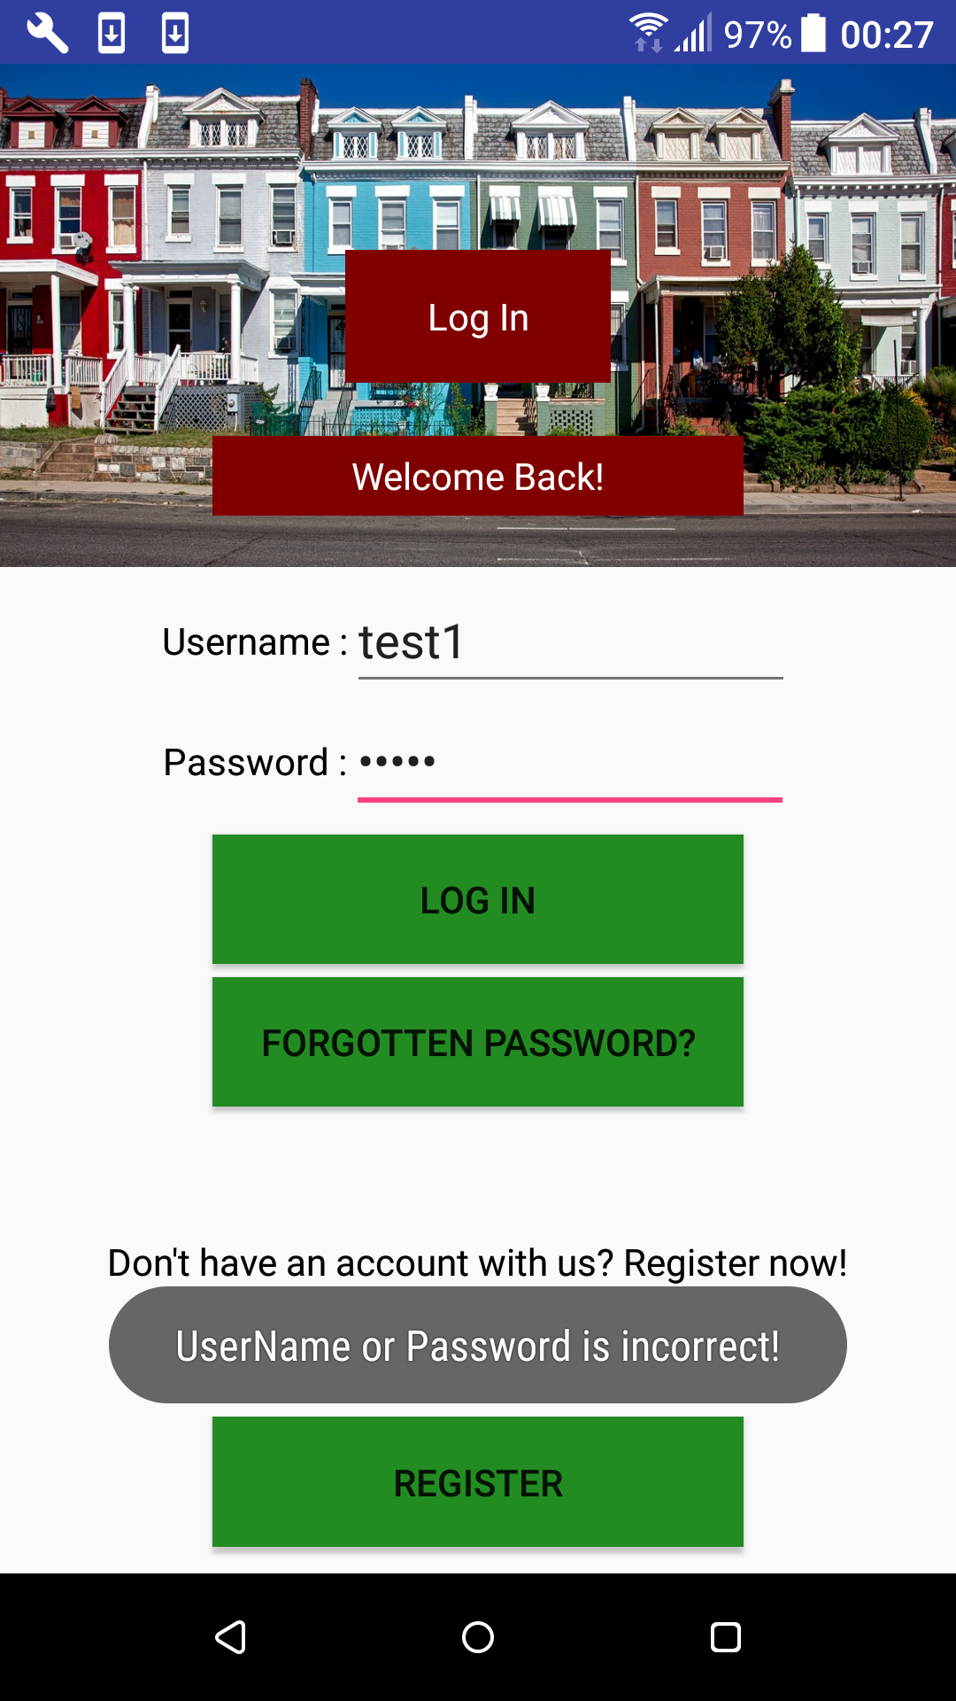
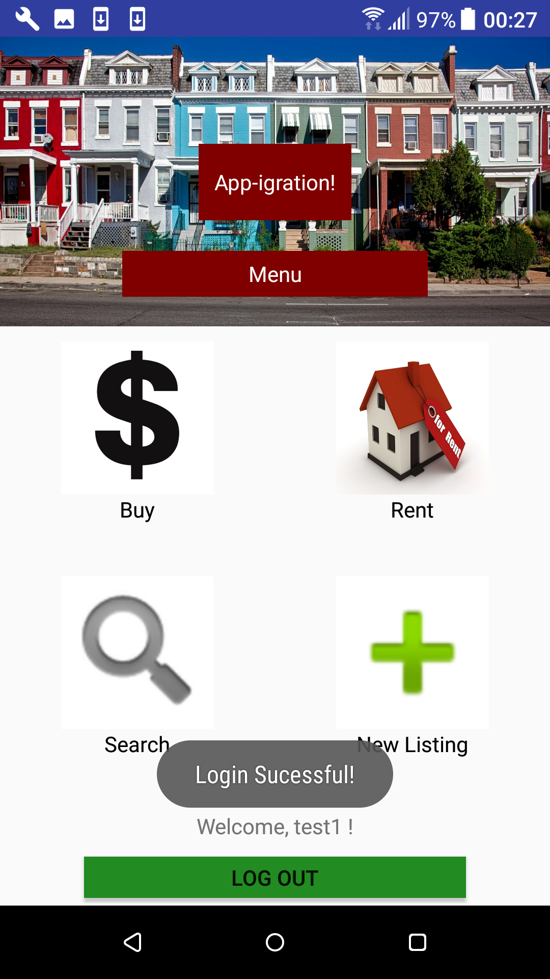

Sprint 3

Slide 18
Sprint 4
Planning Phase
Search for the house on a map
Search by areas of interest
Location tracker

Slide 19
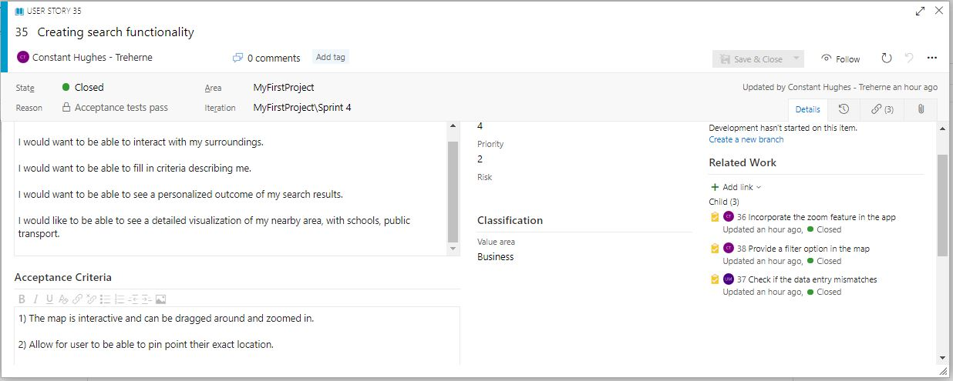
Sprint 4
Sprint User Story
Search using a map
Input data
Zoom in on the map
Acceptance Criteria
User is able to scroll around map
Use location services such as GPS
Search for their preferences
Tick boxes to narrow down search

Slide 20
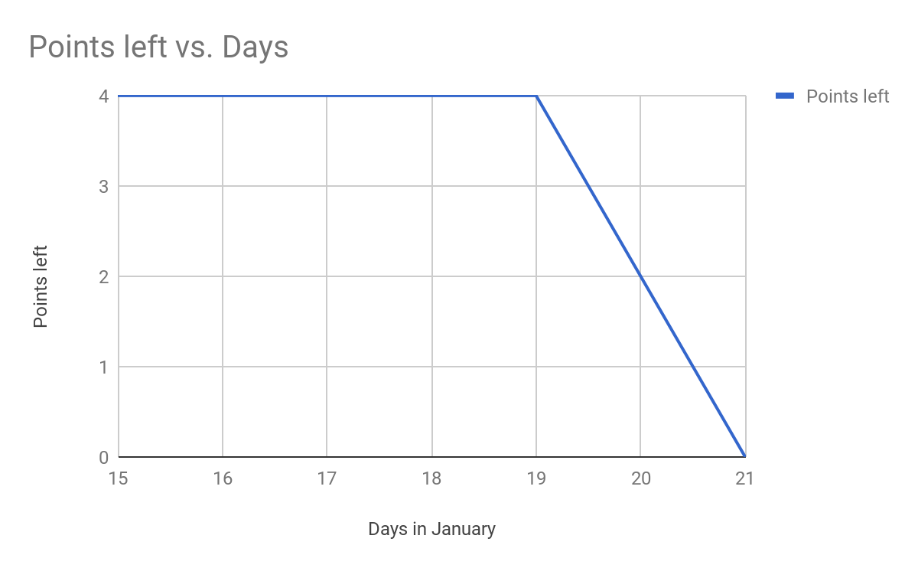
Burndown Chart: Sprint 4

Slide 21
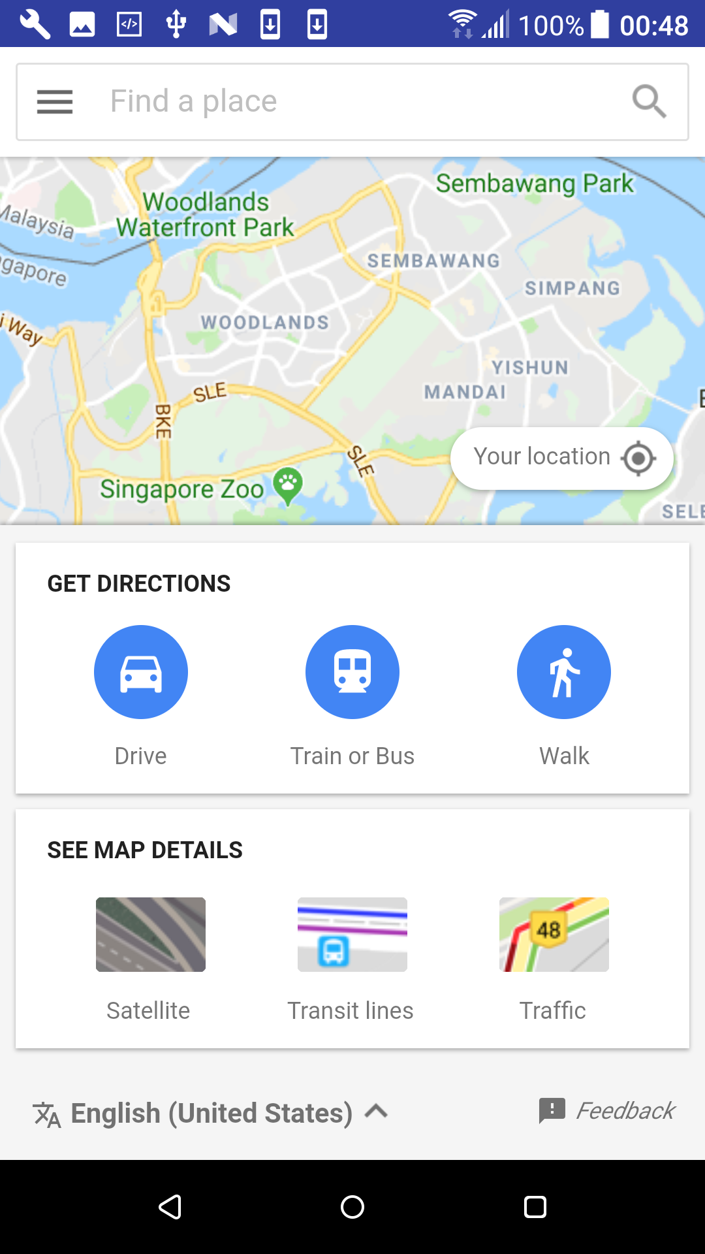
Sprint 4

Slide 22
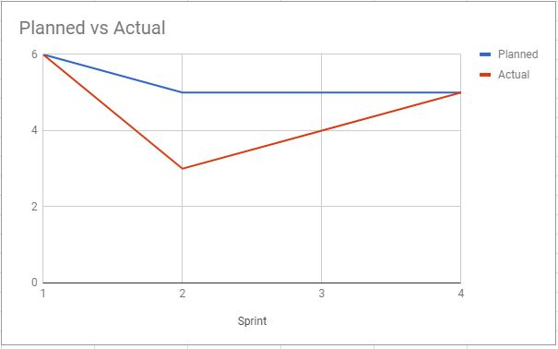
Overall Burndown Chart

Slide 23
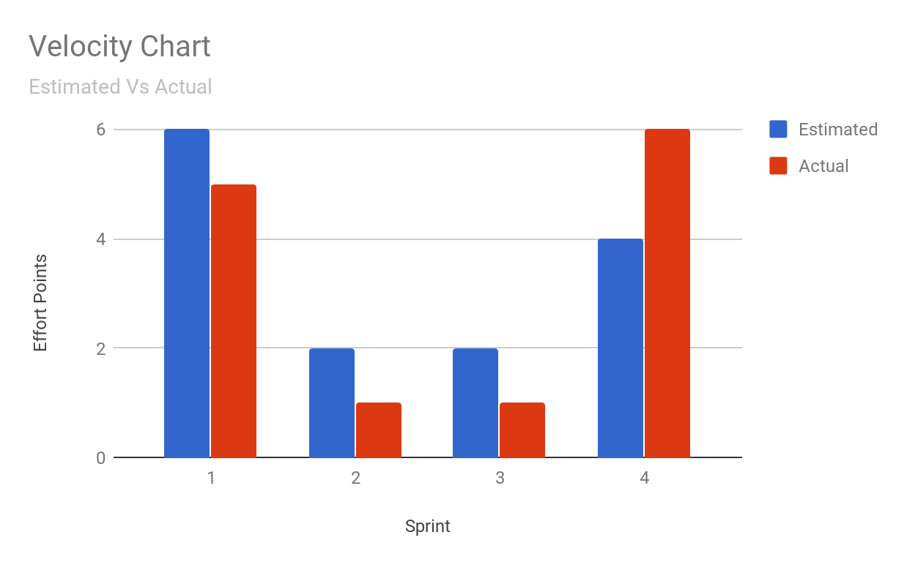
Velocity Chart

Slide 24
Scrum Values
Commitment
Focus
Openness
Respect
Courage

Slide 25
Scrum Principles
Transparency
Inspection
Adaptation

Slide 26
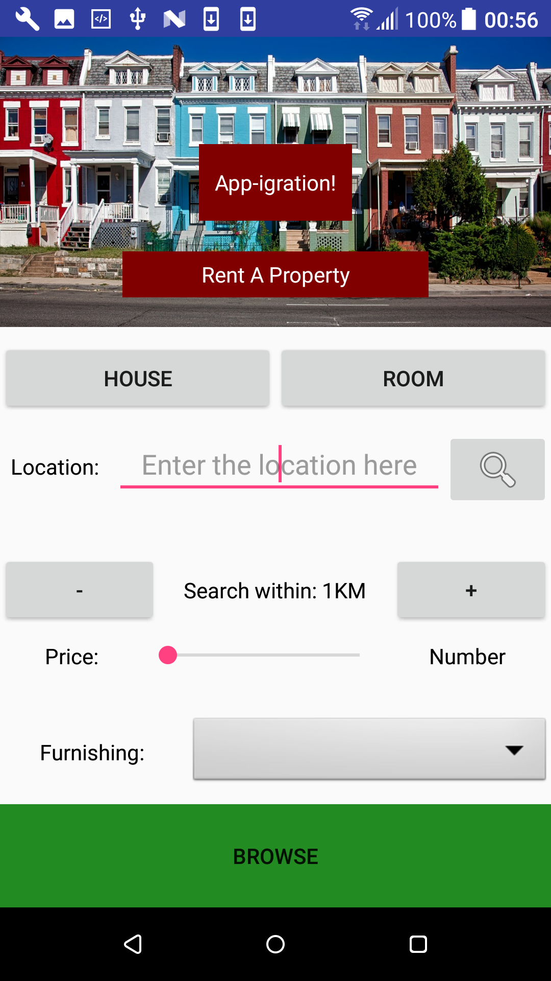
Future Development
Compatibility with multiple devices
User Profile
Improved Database
External Partnerships

Slide 27


